Slide 1
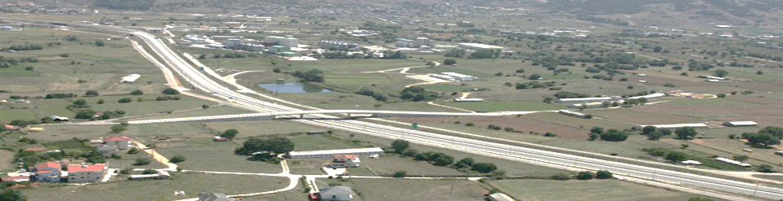
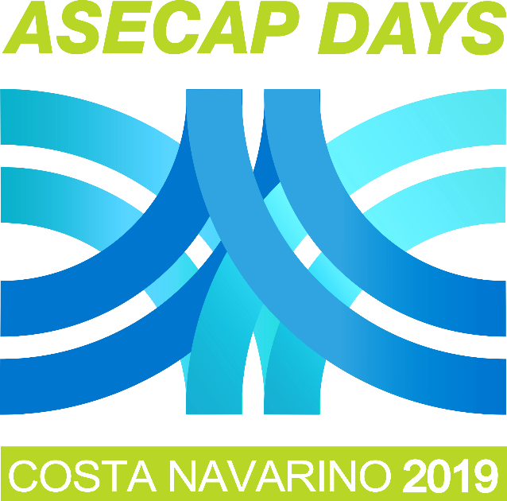

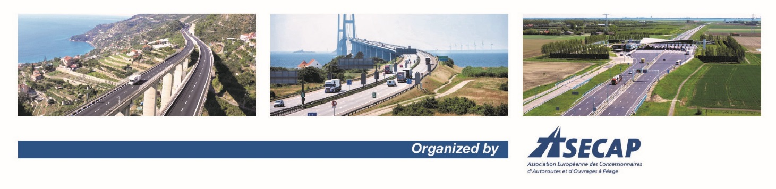
47TH ASECAP STUDY & INFORMATION DAYS
Tomorrow’s Mobility…Is Here Today!
Costa Navarino, Messinia, Greece
29-31 May 2019
www.asecapdays.com
www.asecapdays.com

Slide 2



Infrastructure classification scheme
to support the circulation
of automated vehicles
Stamatis Manganiaris
Institute of Communication and Computer Systems (ICCS)
INFRAMIX project has received funding from the European Union’s Horizon 2020 research and innovation programme under grant agreement no 723016.

Slide 3
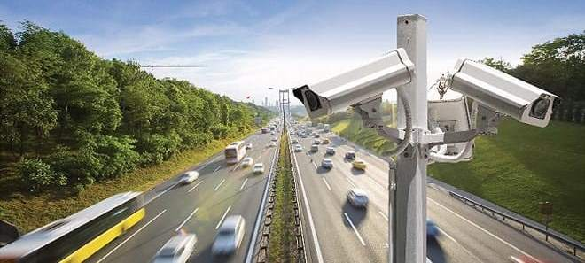
Intelligent Transport Systems (ITS)
Intelligent Mobility is here
ITS is not a matter of automated vehicles ONLY,
it is a matter of effective cooperation of road infrastructure and ALL (AV & conventional) connected vehicles

Slide 4
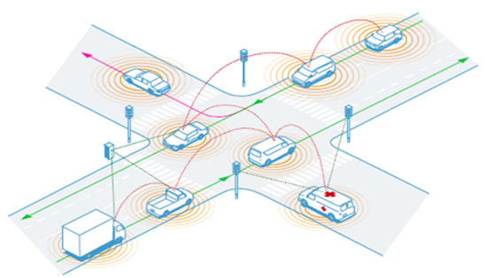
ITS world vision & targets
Vision:
Road infrastructure supporting or even fully controlling the coexistence of conventional and automated vehicles, with enhanced traffic flow efficiency, safety, and user appreciation
Targets:
Increased traffic efficiency by at least 40%
Increased safety by at least 50%
Increased user appreciation by at least 70%
All the above just with increased penetration of automated vehicles by at least 30%

Slide 5
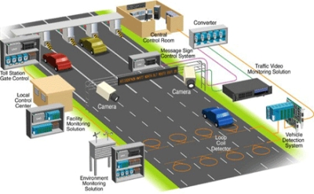
Transport Management Center (TMC)
Only a central player (TMC) can achieve the full potential of automated driving

Slide 6
Cooperative Intelligent
Transport Systems (C-ITS)
Manage traffic demand
Calculate energy and fuel consumption
Give route recommendations
Cooperative Intelligent Transport Systems
(C-ITS)
Choose flow speeds
Optimize travel times and costs
Amazon’s coordination system of AVs (2017) “Lane assignments for autonomous vehicles” generates lane configurations and assignments depending on roadway data

Slide 7
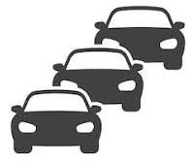


Vehicle-to-Infrastructure (V2I)
V2I cooperation - interoperability will help drivers receive accurate travel alerts such as:
traffic congestion
bad weather conditions
crashes

Slide 8
Five levels of driving automation

Slide 9


Our approach
ISAD levels mapped to digital, physical, and operational elements
Road infrastructure is not just a supporting asset for automated driving
Vehicles and road infrastructure are cooperating components

Slide 10


Important requirements/critical factors
Coherent regulatory framework
Public acceptance improvement

Slide 11
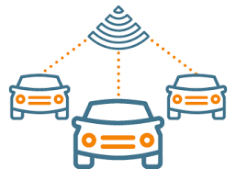
Future challenges
Decision on the level of TMC coordination across different functionalities and ISAD levels
Road infrastructure should serve automated vehicles of different SAE levels, as well as connected conventional vehicles
Requirements definition for the transition from manual to control mode (e.g. minimum risk maneuver by TMC after failure of manual take over control)

Slide 12
More specific challenges
01
Downgrade or upgrade of ISAD level under specific conditions (e.g. weather, traffic incidents, road conditions, technical failures)
05
Information drivers want to get from TMC to make driving safer and more comfortable
02
TMC speed, gap and lane change advice based on individual driving style
06
Road infrastructure requirements for Pay-as-You Go insurance and Pay-as-You Go toll services
03
07
V2I simultaneous speech and screen interaction
V2V communication
04
TMC decision on formation or break-up of platooning
08
Liability for an accident (driver, car manufacturer or the infrastructure authority?)

Slide 13
C-ITS
C-ITS
Enabler for the transition to the concept of mobility as a pure service

